Slide 1

RETAIL SALES AND CUSTOMER ANALYTICS
Done By:S. Haritha
Date:July 2025
Tools Used: EXCEL DATASET, SQL SERVER [ADVANCED], PPT

Slide 2

PROJECT OVERVIEW
Section
Details
Project Goal
Clean, analyze, and generate insights from retail data using SQL Server; calculate KPIs like revenue, segmentation, churn, retention, and product performance.
Dataset
Kaggle Excel dataset imported into SQL Server
Tools
SQL Server, Excel, T-SQL
Techniques
Data cleaning, KPI queries, modular SQL for retention, churn, segmentation, revenue, product performance
Key Outputs
Cleaned tables; insights: total customers, transactions, revenue, trends, segmentation, churn, retention, top & low-performing products
Business Impact
Enabled data-driven decisions; identified high-value customers; highlighted churn risks; supported inventory & marketing strategy
Validation
Cross-checked outputs, verified row counts, ensured financial metrics accuracy, tested query consistency

Slide 3

My STAR Journey

Slide 4
1
SITUATION:
After completing my EV Market Intelligence project with a single dataset using SQL Server, Power BI, DAX, Excel, and PPT, I aimed to advance my SQL skills by working on a multi-dataset retail project using SQL Server only.
2
TASK:
Cleaned and Analyze customer, Monthly sales, and transaction and segmentation data across four datasets to generate business insights, calculate metrics, and understand customer behavior, retention, and revenue patterns.
3
ACTION:
Cleaned all four datasets: removed duplicates, handled nulls, corrected data types, standardized formats, and split date & time.
Inserted cleaned data into structured tables for organized analysis.
Performed joins, CTEs, and aggregations to calculate key metrics.
AI as a learning assistant while independently designing relationships and writing optimized queries to deliver business insights.
4
RESULT:
Successfully integrated multiple datasets into clean, query-ready tables.
Delivered metrics-driven business insights entirely using SQL Server.
Gained hands-on experience in advanced SQL, data cleaning, and multi-table analysis.
Learned to efficiently select relevant columns, manage relationships, and extract insights.
Strengthened end-to-end data preparation and analysis skills for real-world retail problems.

Slide 5

Key Achievements & Skills
Successfully executed my first advanced SQL project, integrating and analyzing four complex datasets entirely within SQL Server.
Gained hands-on experience in building multi-table relationships and writing efficient queries for meaningful business insights.
Strengthened data cleaning and transformation skills, including removing duplicates, trimming strings, handling nulls, and splitting datetime columns.
Applied SQL to calculate key business metrics, delivering actionable insights for revenue, customer behavior, and product performance.
Developed problem-solving skills by troubleshooting complex queries and optimizing performance, demonstrating analytical independence.
Leveraged AI guidance strategically to validate approaches, ensuring accuracy and reliability of results.
Built a strong foundation for future work in EDA, machine learning, and cloud-based data solutions (AWS).

Slide 6
ABOUT THE DATASET
• Dataset Source: Kaggle – retail_cleaned.csv, retail_segment.csv, monthly_sales copy.csv, customer_summary copy.csv
•Total Rows:
Uncleaned Dataset Name
Cleaned New table Name
Total Rows
cleaned_retail_final
retail_cleaned.csv
519,600
cleaned_retail_segment
retail_segment.csv
387,841
cleaned_monthly_sales
monthly_sales copy.csv
13
cleaned_customer_summary
customer_summary copy.csv
4,338

Slide 7
TABLE
1. Cleaned Monthly Sales Dataset
Table Name:cleaned_monthly_sales
Purpose: This dataset contains aggregated monthly revenue information derived from the transactional dataset.
It helps track overall business performance, sales trends, and seasonal patterns.
Key Columns:
Column Name | Description | Example
InvoiceMonth | The month of the transaction | 2010-12-01
Monthly_Revenue | Total revenue generated in that month | 823,746

Slide 8
Sample Data:
InvoiceMonth | Monthly Revenue
2010-12-01 | 823,746
2011-01-01 | 691,364
Insights Possible:
Tracking monthly revenue trends
Identifying high-performing and low-performing months
Forecasting future monthly sales

Slide 9
Dataset Cleaning
(monthly_sales copy) → cleaned_monthly_sales
Removed duplicate records based on InvoiceMonth, keeping the highest monthly_revenue.
Removed rows with NULL values, invalid placeholders, or zero/negative revenue.
Standardized InvoiceMonth to the first day of each month in DATE format.
Converted monthly_revenue to an INT and rounded it.
Reformatted the invoice month into dd-MM-yyyy for uniform reporting.
Stored the cleaned results into the final table: cleaned_monthly_sales.

Slide 10
TABLE
2. Cleaned Retail Segment Dataset
This dataset focuses on customer segmentation and captures transaction-level details along with assigned customer segments. It helps in identifying customer purchasing patterns and classifying them into different behavioral groups.
Key Columns :
Column Name | Description | Example
InvoiceNo | Unique invoice number | 580460
StockCode | Product code | 23320
Description | Product description | GIANT 50'S CHRISTMAS CRACKER
Quantity | Number of items purchased | 1
UnitPrice | Price per unit | 1.25
CustomerID | Unique customer ID | 12748
Country | Country of purchase | United Kingdom
TotalPrice | Total revenue for that invoice line | 1.25
InvoiceMonth | Month of the transaction | 2011-01-12
Segment | Customer segment classification | 3
Invoice_Date | Date of invoice | 2011-12-04
Invoice_Time | Time of invoice | 12:29:00
580460
GIANT 50'S CHRISTMAS CRACKER
1
1.25
12748
United Kingdom
1.25
2011-01-12
3
2011-12-04
12:29:00
Insights Possible:
Customer segmentation based on RFM analysis
Purchase patterns across different segments
High-value vs. low-value customer profiling

Slide 11
SAMPLE DATASET:
Invoice No | Stock Code | Description | Quantity | Unit Price | Custom ID | Country | Total Price | Invoice Month | Seg ment | Invoice Date | In voice Time
580460 | 23320 | GIANT 50'S CHRISTMAS CRACKER | 1 | 1.25 | 12748 | United Kingdom | 1.25 | 2011-01-12 | 3 | 2011-12-04 | 12:29:00
Insights Possible:
Customer segmentation based on RFM analysis
Purchase patterns across different segments
High-value vs. low-value customer profiling

Slide 12
Dataset Cleaning
(retail_segmented) → cleaned_retail_segment
Removed duplicate rows based on InvoiceNo + StockCode.
Converted numeric fields into correct data types:
UnitPrice → DECIMAL(10,2)
TotalPrice → DECIMAL(10,2)
Quantity → INT
CustomerID → INT
Extracted and standardized Invoice_Date and Invoice_Time fields from the original InvoiceDate column.
Dropped redundant columns after transformation.
Created the cleaned table: cleaned_retail_segment.

Slide 13
TABLE
3. Cleaned Retail Final Dataset
Table Name: Cleaned_retail_final
Purpose : This dataset contains complete transaction-level retail data, capturing every purchase detail, including products, pricing, dates, and invoice metadata. It serves as the primary dataset for overall sales analysis.
Key Columns:
Column Name | Description | Example
InvoiceNo | Unique invoice identifier | 537429
StockCode | Product code | 20975
Description | Product description | 12 PENCILS SMALL TUBE RED RETROSPOT
Quantity | Units purchased | 2
UnitPrice | Price per unit | 0.65
CustomerID | Unique customer identifier | 12748
Country | Country where purchase occurred | United Kingdom
TotalPrice | Total revenue for the line item | 1.30
InvoiceMonth | Month of transaction | 2010-12-01
Invoice_Date | Transaction date | 2010-12-06
Invoice_Time | Transaction time | 15:54:00

Slide 14
Dataset Cleaning
(retail_cleaned) → cleaned_retail_final
Checked the table structure and removed duplicate rows based on a combination of InvoiceNo + StockCode.
Added separate columns for Invoice_Date and Invoice_Time and converted them into proper DATE and TIME formats.
Ensured InvoiceMonth was stored as a valid DATE field.
Converted numeric fields into correct data types:
Quantity → INT
UnitPrice → DECIMAL(10,2)
TotalPrice → DECIMAL(10,2)
Dropped unnecessary columns like the original InvoiceDate.
Created the cleaned table: cleaned_retail_final.

Slide 15
SAMPLE DATASET:
InvoiceNo | Stock Code | Description | Quantiy | Unit Price | Custom ID | Country | Total Price | Invoice Month | Invoice Date | Invoice Time
537429 | 20975 | 12 PENCILS SMALL TUBE RED RETROSPOT | 2 | 0.65 | 12748 | United Kingdom | 1.30 | 2010-12-01 | 2010-12-06 | 15:54:00
Insights Possible:
Product-level performance tracking
Top-selling products and revenue contribution
Invoice-level analysis for profitability
Seasonal purchase behavior

Slide 16
TABLE
4. Cleaned Customer Summary Dataset
Table Name: Cleaned_retail summary
Purpose: This dataset provides an aggregated view of customer behavior, including total transactions, spending, and purchase timelines. It is useful for evaluating customer lifetime value and retention patterns.
Sample Data:
Key Columns:
Column Name | Description | Example
CustomerID | Unique customer identifier | 12346
Total_Quantity | Total products purchased | 1
Total_Order | Number of orders placed | 74,215
Total_Spent | Total amount spent by the customer | 77,183.60
First_Purchase_Date | First transaction date | 2011-01-18
First_Purchase_Time | First transaction time | 10:01:00
Last_Purchase_Date | Most recent transaction date | 2011-12-07
Last_Purchase_Time | Most recent transaction time | 15:52:00

Slide 17
SAMPLE DATASET:
CustomerID | Total Quantity | Total Orders | Total Spent | First Purchase Date | First Purchase Time | Last Purchase Date | Last Purchase Time
12346 | 1 | 74,215 | 77,183.60 | 2011-01-18 | 10:01:00 | 2011-12-07 | 15:52:00
Insights Possible:
Customer lifetime value (CLV) estimation
Identifying high-value vs. churn-risk customers
Analyzing first vs. last purchase timelines
Evaluating overall customer contribution to revenue

Slide 18
Dataset Cleaning
(customer_summary copy) → cleaned_customer_summary
Checked the table structure and validated data types.
Removed duplicate rows based on CustomerID.
Handled NULL values and invalid placeholders like 'NA', 'NULL', and empty strings.
Removed customers with zero or negative orders, negative quantities, or negative spending.
Rounded the total_spent column to 2 decimal places for consistency.
Split the first_purchase and last_purchase datetime columns into separate date and time fields.
Converted columns into correct data types:
CustomerID → INT
total_orders → INT
total_spent → DECIMAL(10,2)
Created a final cleaned table: cleaned_customer_summary.

Slide 19
BUSINESS PROBLEM
How can SQL Server be used to clean, prepare, and analyze an online retail sales dataset to uncover insights on customer behavior, product performance, revenue trends, and customer retention and churn, in order to support data-driven business decisions?
WHO IS IT USEFUL FOR?
Who
How It’s Useful
Business Analysts / Data Analysts
Track sales trends, analyze customer behavior, identify high-value & churn customers
Marketing Teams
Target campaigns using customer segments, improve retention & engagement
Sales & Product Managers
Optimize product performance, plan inventory, focus on top-selling products
Executives / Decision-Makers
Make strategic decisions using KPIs like revenue trends, LTV, and retention
Data Engineers / DB Admins
Work with cleaned, standardized data for accurate reporting and analytics

Slide 20

Unlocking Actionable Insights from Retail Data
Based on the cleaned datasets and analysis, we have derived key insights across customers, sales, retention, engagement, and revenue metrics.
" These insights help understand customer behavior, identify growth opportunities, and support strategic decisions.”

Slide 21

Data-Driven Insights at a Glance
Overall context
Time - Based Overview
Total customers
Monthly orders
Total orders/ transactions
Monthly revenue
Total revenue
Weekly orders
Total Products
New vs Returning customer
Weekly revenue
Average order per customer
Customer Activity Metrics
Average revenue per customer
Number of customers per segment
Revenue contribution by category
Top selling products
Percentage of active customers
Low-performing products
Customers with no purchase in the last 6 months
Average time between purchases
Funnel Analysis
Retention Analysis
Customers who placed at least one order
Monthly retention rate
Conversion rate (first purchase -> repeat purchase)
Average time between first and second purchase
Segment wise retention

Slide 22

Churn Rate
Engagement Metrics
Customers inactive in last 3, 6, 12 months
Total quantity purchased per customer per month
Monthly churn rate
Average spend per order
High-value customers at risk of churn
Time-of-day & day-of-week shopping activity
Referral and Loyalty Metrics
Activation Rate
Percentage of new customers purchasing within X days
Repeat customers
Loyalty contribution to revenue
Time to first purchase
Activation rate by segment
Revenue Metrics
Monthly revenue trends
Revenue by customer segement
Customer Lifetime Value [LTV]

Slide 23
Sample sql server queries and outputs

Slide 24
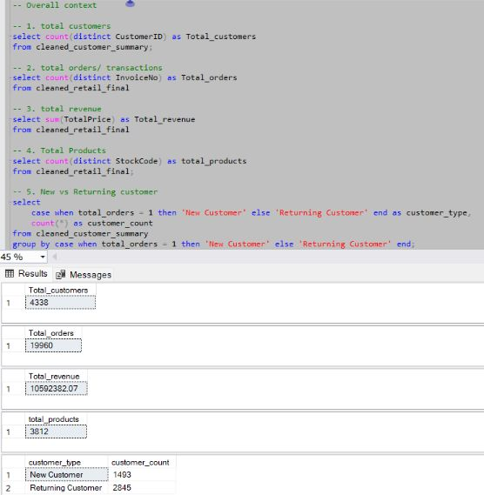
OVERALL CONTEXT
“These are 5 out of 11 key insights derived using SQL Server queries.”
The business has a total of 4,338 unique customers.
There are 19,960 total orders recorded across all transactions.
The company has generated ₹10,59,238.07 in total revenue.
A total of 3,812 unique products have been sold.
Customer Segmentation:
1,493 new customers (34%)
2,845 returning customers (66%) → Returning customers contribute a major share of overall business activity.

Slide 25
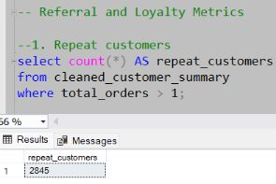
Referral and loyalty metrics

Slide 26
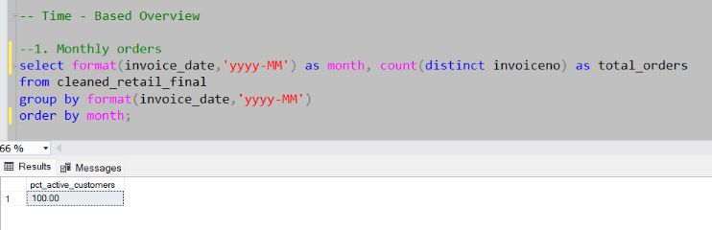
Time – based overview

Slide 27
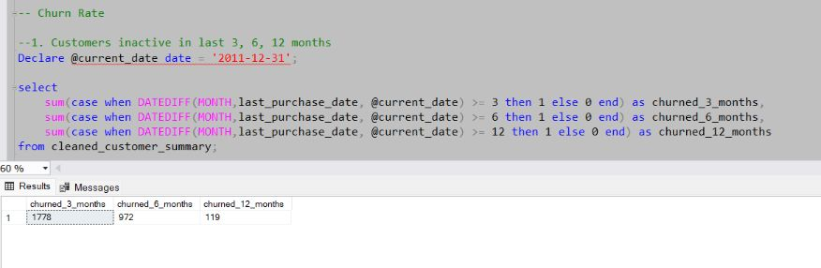
Churn rate

Slide 28
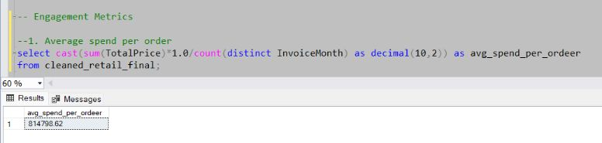
Engagement metrics

Slide 29
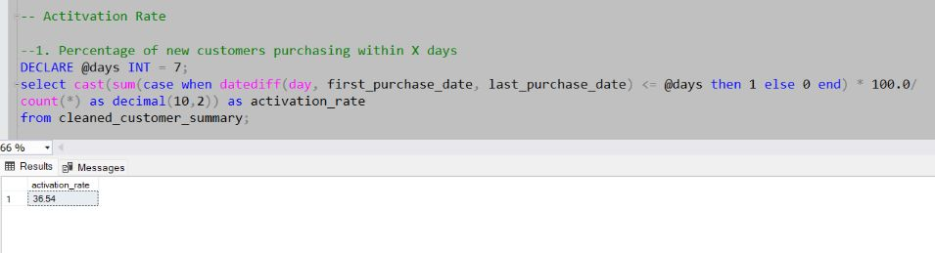
Activation metrics

Slide 30
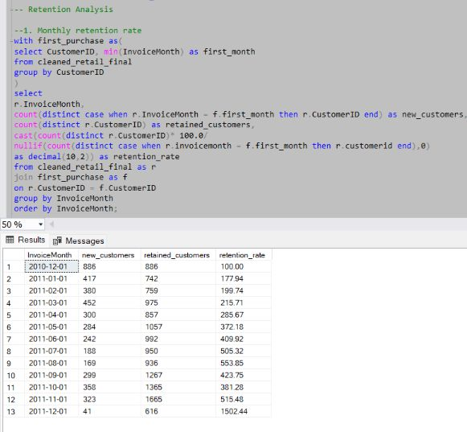
Retention analysis

Slide 31
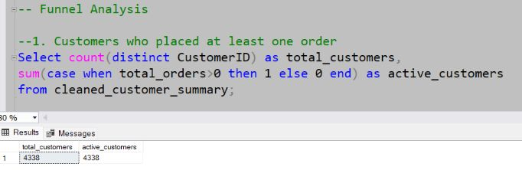
Funnel analysis

Slide 32
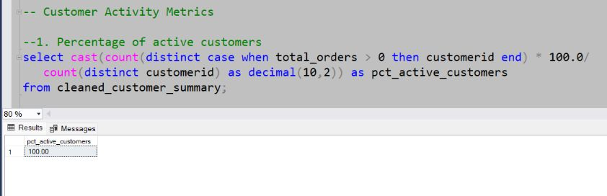
Customer activity metrics

Slide 33
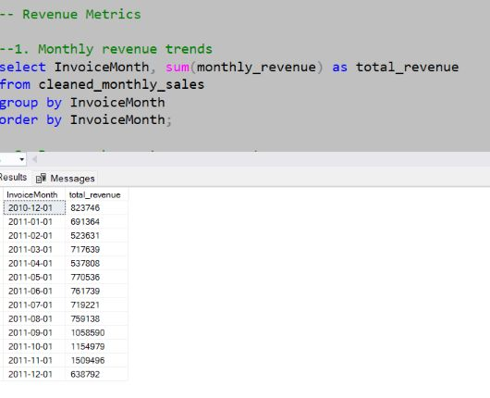
Revenue metrics

Slide 34

Summary of Insights
66% of customers are returning buyers, and they contribute the highest share of total revenue.
Top 20 high-value customers identified using LTV analysis for loyalty and retention programs.
Segment 1 customers found to be at risk of churn, need to target them with
retention campaigns.
Identified top-performing products and high-value customer segments to improve
marketing and inventory planning.
Seasonal peaks observed during Nov–Dec, helping plan promotions and stock availability.
Activation rate within 7 days is around 37%, while the average time to first purchase is ~130 days, indicating opportunities to improve onboarding.

Slide 35

Business Recommendations
Since 66% of revenue comes from returning customers, focus on strengthening loyalty programs and providing personalized offers to retain them.
Segment 1 customers are at high churn risk, so plan targeted retention campaigns to keep them engaged.
Use the LTV analysis to build exclusive benefits for the top 20 high-value customers and improve overall retention and revenue.
The activation rate is 37%, but the average first purchase takes ~130 days → improve onboarding and early engagement strategies to reduce this gap.
Utilize the seasonal peaks in Nov–Dec to plan better promotions, discounts, and inventory stocking to maximize sales.
Focus on top-performing products for marketing and sales strategies while reviewing low-performing items for pricing, bundling, or clearance.

Slide 36

Conclusion
This project helped me clean, analyze, and generate actionable insights from the retail sales data using SQL Server. By understanding customer behavior, sales patterns, and product performance, I was able to identify key growth opportunities and churn risks.
The analysis highlights the importance of focusing on returning customers, improving activation rates, optimizing marketing strategies, and planning inventory based on seasonal trends.
Overall, this project strengthened my SQL, data cleaning, and analytical skills, while delivering insights that can support data-driven business decisionsand enhance future strategies.

